Slide 1

Jupyter notebooks and their widgets
Jean Bilheux
Neutron Imaging Computer Instrument Scientist
Materials Engineering Group
Neutron Scattering Division
ASM - 2023
Development

Slide 2
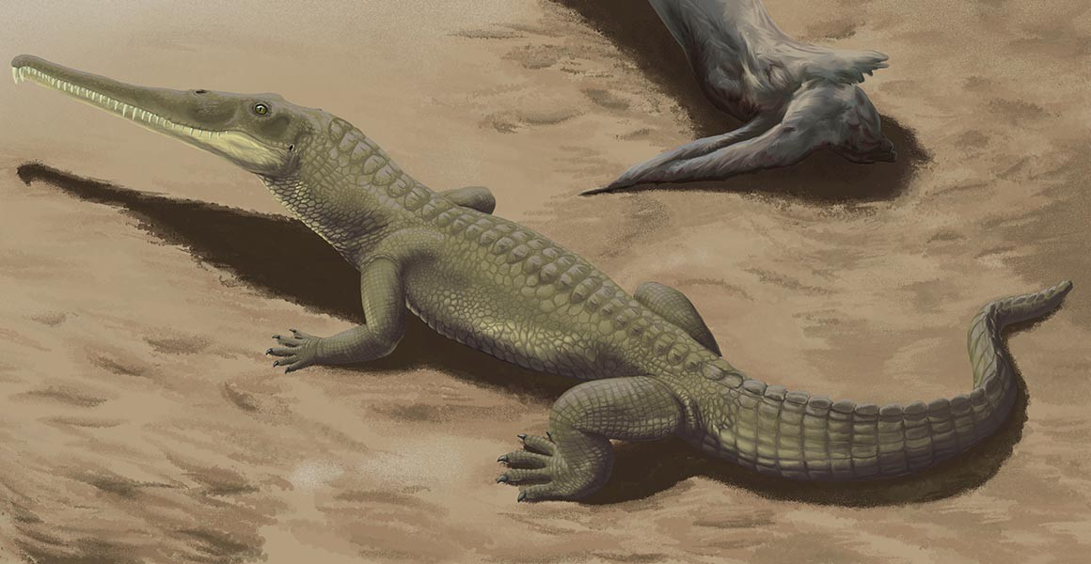
Table of Contents
Neutron imaging technique
Jupyter notebooks
Hands on using simple jupyter notebooks
Make a Jupyter notebook interactive
Demo of notebooks with widgets
Integrating a full user interface with a Jupyter notebook
Sample: Phytosaur teeth
https://github.com/neutrons/asm_2023/tree/main/jean
Notes:
Here is how we gonna spent the next 45 minutes.
I will start by showing you what I have been doing before joining the imaging team.
Then in the first part I will describe my work as an imaging software developer
In the second part, I will talk about my work as Embedded imaging software developer and you will see how much the *embedded* word is important.
Finally I will give my vision of the CIS position

Slide 3
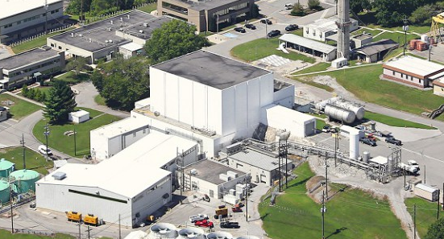

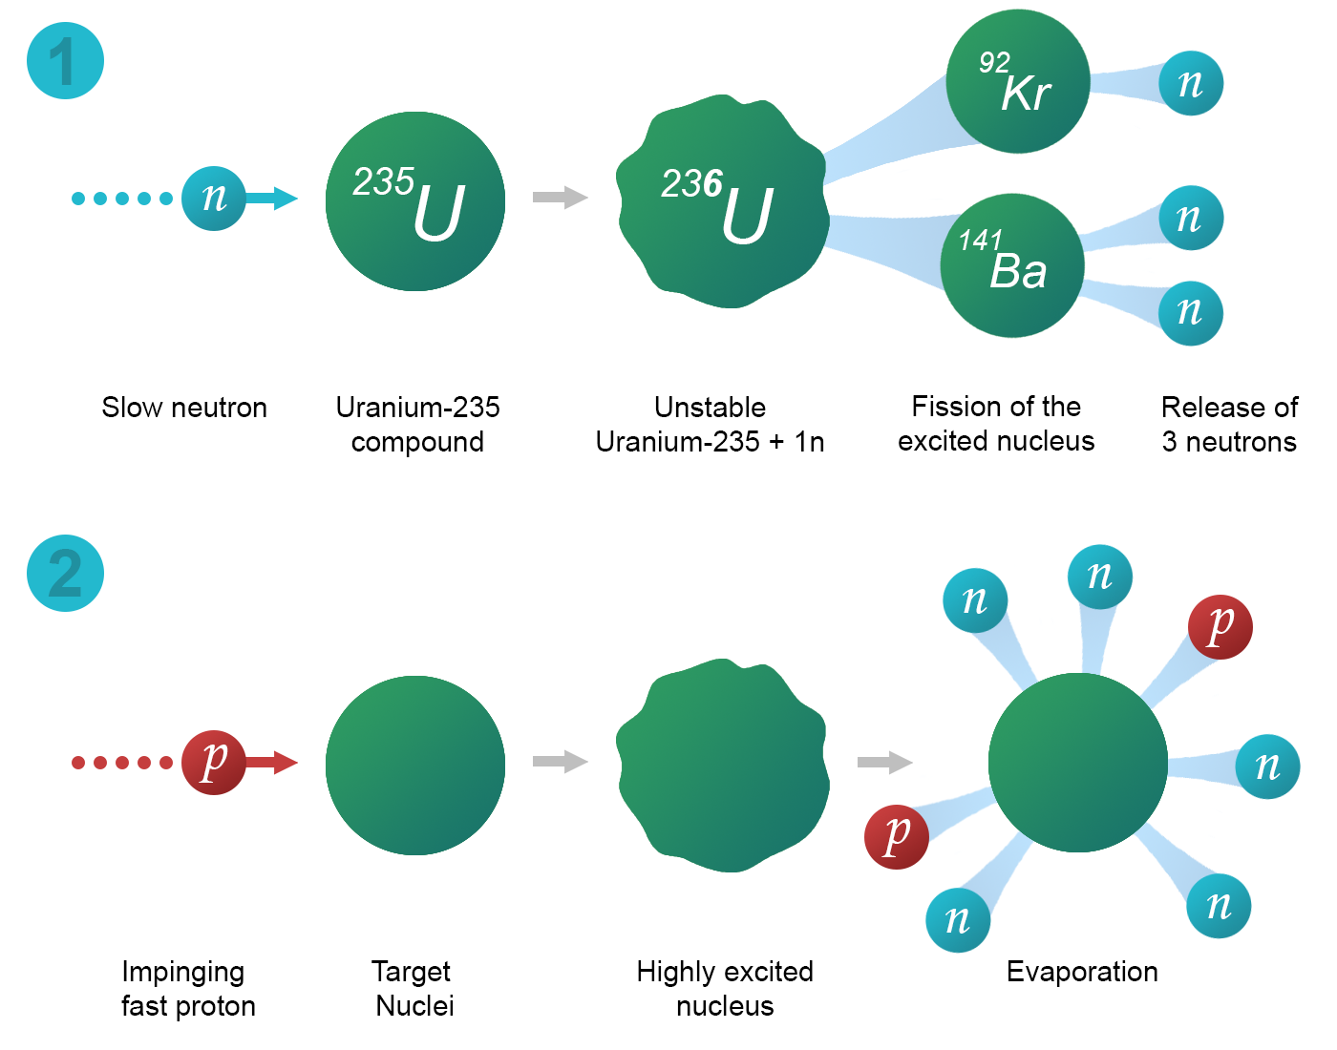
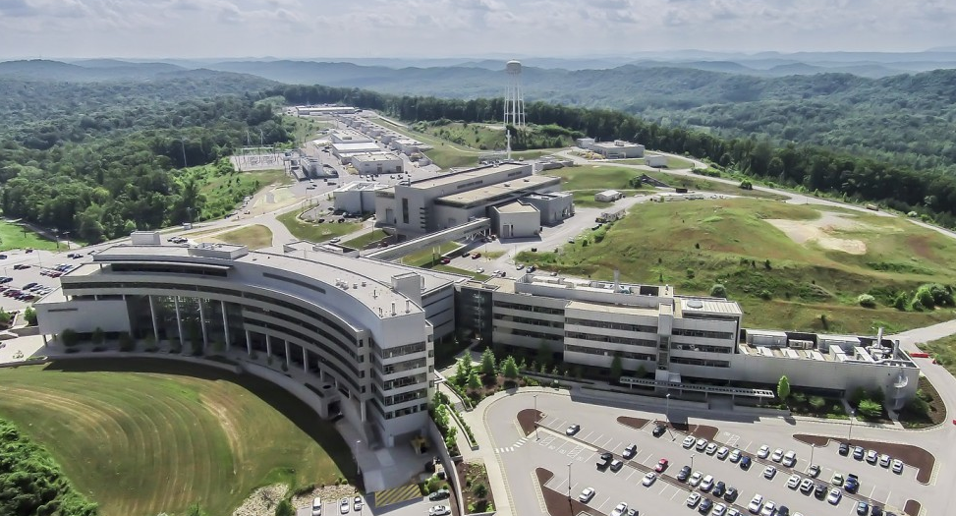
Neutron Imaging
Fission (Continuous)
Spallation (Pulsed)
https://pan-learning.org/wiki/index.php/Introduction_to_neutron_scattering

Slide 4
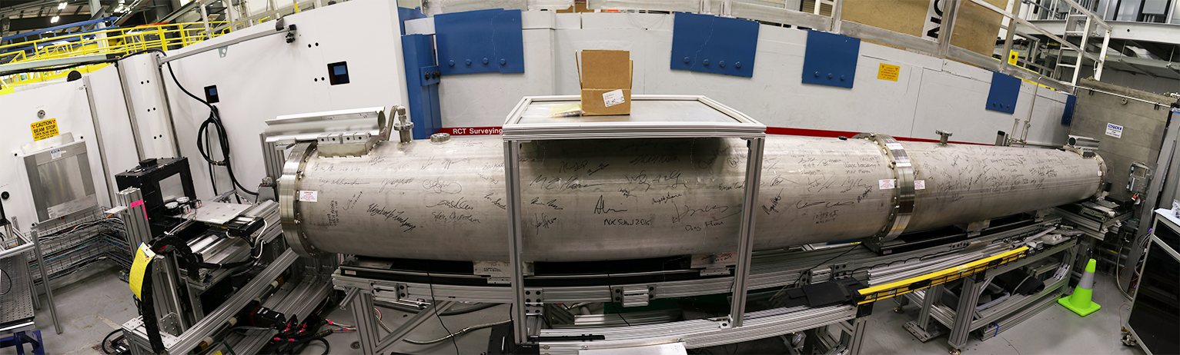
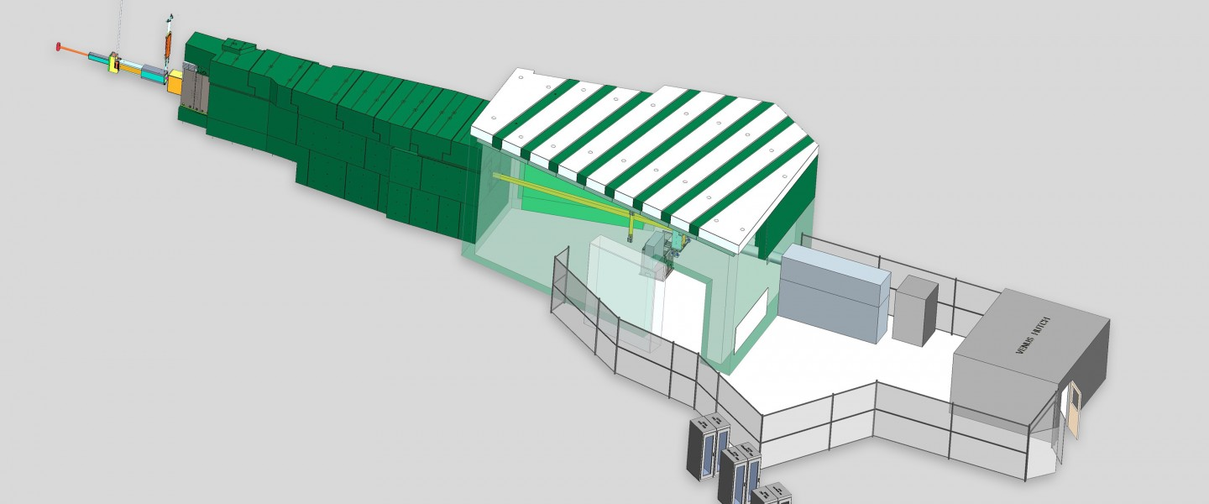
We have both HFIR and SNS at ORNL
Fission (Continuous)
MARS – Multimodal Advanced Radiography Station
(dedicated cold neutron imaging instrument)
https://neutrons.ornl.gov/mars
Spallation (Pulsed)
VENUS – Versatile Neutron Imaging Instrument
(time-of-flight imaging instrument, under construction)
https://neutrons.ornl.gov/venus

Slide 5
Neutron Imaging
Type of science

Slide 6
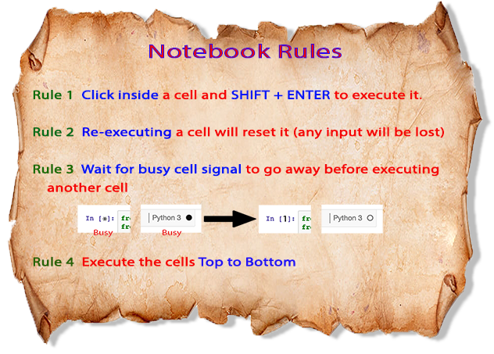
Jupyter notebooks
Notes:
Presentation of what they are, how to get them, and to run them

Slide 7
Hand-on – cropping a stack of images
PLAN
Load the images
Visualize
Select region to crop
Visualize result
Export new images
jean/exercises/notebook_without_widgets_example1.ipynb

Slide 8
Hand-on – cropping a stack of images
NEW PLAN using widgets
Load the images
Visualize
Select region to crop
Visualize result
Export new images

Slide 9
More advanced used of widgets
Topaz config file
Timepix3
Group images per cycle for panoramic stitching
Advanced normalization

